Slide 1
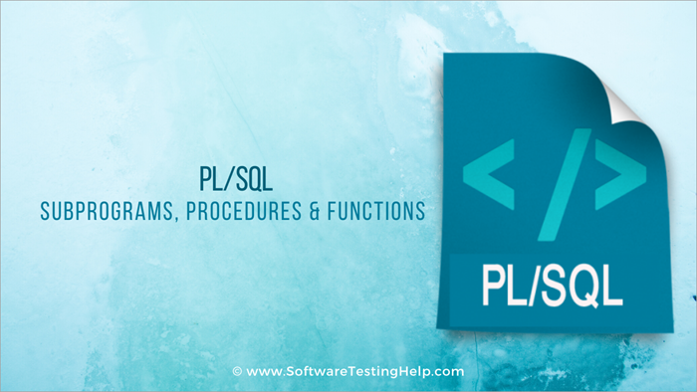
PL/SQL SUBPROGRAMS

Slide 2
What is subprogram in PL SQL?
A PL/SQL subprogram is a named PL/SQL block that can be invoked repeatedly.
If the subprogram has parameters, their values can differ for each invocation.
A subprogram is either a procedure or a function.
Typically, you use a procedure to perform an action and a function to compute and return a value.

Slide 3
Parameter:
The parameter is variable or placeholder of any valid PL/SQL datatype through which the PL/SQL subprogram exchange the values with the main code. This parameter allows to give input to the subprograms and to extract from these subprograms.
These parameters should be defined along with the subprograms at the time of creation.
These parameters are included n the calling statement of these subprograms to interact the values with the subprograms.
The datatype of the parameter in the subprogram and the calling statement should be same.
The size of the datatype should not mention at the time of parameter declaration, as the size is dynamic for this type.

Slide 4

Based on their purpose parameters are classified as:
IN Parameter
OUT Parameter
IN OUT Parameter

Slide 5

IN Parameter:
This parameter is used for giving input to the subprograms.
It is a read-only variable inside the subprograms. Their values cannot be changed inside the subprogram.
In the calling statement, these parameters can be a variable or a literal value or an expression, for example, it could be the arithmetic expression like '5*8' or 'a/b' where 'a' and 'b' are variables.
By default, the parameters are of IN type.

Slide 6

OUT Parameter:
This parameter is used for getting output from the subprograms.
It is a read-write variable inside the subprograms. Their values can be changed inside the subprograms.
In the calling statement, these parameters should always be a variable to hold the value from the current subprograms.

Slide 7

IN OUT Parameter:
This parameter is used for both giving input and for getting output from the subprograms.
It is a read-write variable inside the subprograms. Their values can be changed inside the subprograms.
In the calling statement, these parameters should always be a variable to hold the value from the subprograms.
These parameter type should be mentioned at the time of creating the subprograms.

Slide 8
RETURN:
RETURN is the keyword that instructs the compiler to switch the control from the subprogram to the calling statement.
In subprogram RETURN simply means that the control needs to exit from the subprogram. Once the controller finds RETURN keyword in the subprogram, the code after this will be skipped.
Normally, parent or main block will call the subprograms, and then the control will shift from those parent block to the called subprograms.
RETURN in the subprogram will return the control back to their parent block.
In the case of functions RETURN statement also returns the value.
The datatype of this value is always mentioned at the time of function declaration. The datatype can be of any valid PL/SQL data type.

Slide 9

PL/SQL Functions

Slide 10
A function is a named PL/SQL Block
The major difference between a procedure and a function is, a function must always return a value, but a procedure may or may not return a value.
Functions is a standalone PL/SQL subprogram.
Functions has a unique name by which it can be referred. These are stored as PL/SQL database objects

Slide 11
FUNCTIONS
The significant difference is that a function is a PL/SQL block that returns a single value.
Functions can accept one, many, or no parameters, but a function must have a return clause in the executable section of the function.
The datatype of the return value must be declared in the header of the function.
A function is not a stand-alone executable in the way that a procedure is: It must be used in some context. You can think of it as a sentence fragment.
A function has output that needs to be assigned to a variable, or it can be used in a SELECT statement.

Slide 12
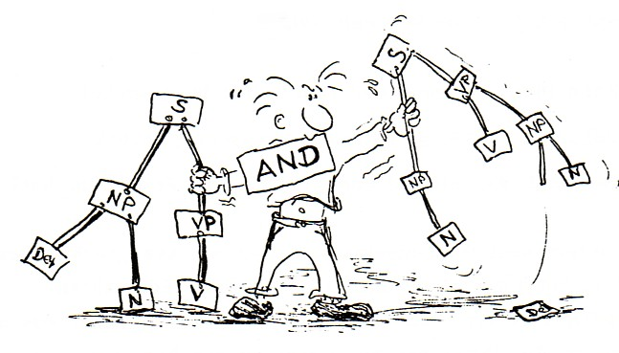
FUNCTIONS
The syntax for creating a function is as follows:
CREATE [OR REPLACE] FUNCTION function_name [parameters]
RETURN return_datatype;
IS
Declaration_section
BEGIN
Execution_section
Return return_variable;
EXCEPTION
exception section
Return return_variable;
END;

Slide 13
FUNCTIONS
The function does not necessarily have to have any parameters, but it must have a RETURN value declared in the header, and it must return values for all the varying possible execution streams.
The RETURN statement does not have to appear as the last line of the main execution section, and there may be more than one RETURN statement (there should be a RETURN statement for each exception).
A function may have IN, OUT, or IN OUT parameters. but you rarely see anything except IN parameters.

Slide 14

Return Type:
The header section defines the return type of the function.
The return datatype can be any of the oracle datatype like varchar, number. 2) The execution and exception section both should return a value which is of the datatype defined in the header section.
function-name specifies the name of the function.
[OR REPLACE] option allows modifying an existing function.
The optional parameter list contains name, mode and types of the parameters.
IN represents that value will be passed from outside and OUT represents that this parameter will be used to return a value outside of the procedure.
RETURN clause specifies that data type you are going to return from the function.
function-body contains the executable part.

Slide 15

Key points about functions..

Slide 16
Functions are a standalone block that is mainly used for calculation purpose.
Function use RETURN keyword to return the value, and the datatype of this is defined at the time of creation.
Function should either return a value or raise the exception, i.e. return is mandatory in functions.
Function with no DML statements can be directly called in SELECT query whereas the function with DML operation can only be called from other PL/SQL blocks.
It can have nested blocks, or it can be defined and nested inside the other blocks or packages.

Slide 17
It contains declaration part (optional), execution part, exception handling part (optional).
The values can be passed into the function or fetched from the procedure through the parameters.
These parameters should be included in the calling statement.
Function can also return the value through OUT parameters other than using RETURN.
Since it will always return the value, in calling statement it always accompany with assignment operator to populate the variables.

Slide 18
Every function has two parts:
The header portion, which comes before AS (sometimes you will see IS—they are interchangeable), keyword (this contains the function name and the parameter list),
The body, which is everything after the IS keyword.
The word REPLACE is optional.
When the word REPLACE is not used in the header of the function, in order to change the code in the header, it must be dropped first and then re-created.

Slide 19
PARAMETERS
Parameters are the means to pass values to and from the calling environment to the server.
These are the values that will be processed or returned via the execution of the procedure.
There are three types of parameters:
IN, OUT, and IN OUT.
Modes specify whether the parameter passed is read in or a receptacle for what comes out.

Slide 20
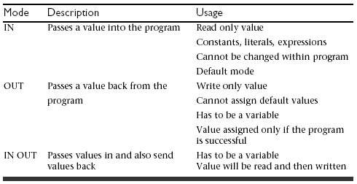
Types of Parameters

Slide 21
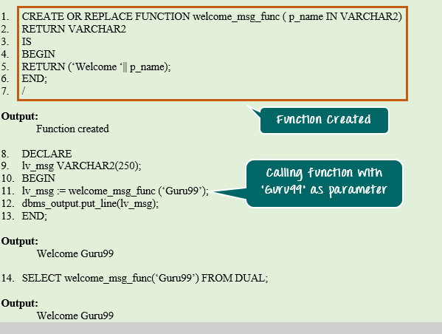

Slide 22
SIMPLE EXAMPLE TO DISPLAY A NAME WITH A MESSAGE
Simple function
Greetings example
Area calculation

Slide 23
FORMAL AND ACTUAL PARAMETERS
Formal parameters are the names specified within parentheses as part of the header of a module.
Actual parameters are the values—expressions specified within parentheses as a parameter list—when a call is made to the module.
The formal parameter and the related actual parameter must be of the same or compatible data types.

Slide 24
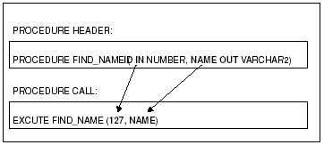
MATCHING ACTUAL AND FORMAL PARAMETERS

Slide 25
Example
CREATE OR REPLACE FUNCTION show_description
(i_course_no number)
RETURN varchar2
AS
v_description varchar2(50);
BEGIN
SELECT description
INTO v_description
FROM course
WHERE course_no = i_course_no;
RETURN v_description;
EXCEPTION
WHEN NO_DATA_FOUND
THEN
RETURN('The Course is not in the database');
WHEN OTHERS
THEN
RETURN('Error in running show_description');
END;

Slide 26
For example, let’s create a function called ''empdetails'
CREATE OR REPLACE FUNCTION empdetails
RETURN VARCHAR2 IS
emp_name VARCHAR2(30);
BEGIN
SELECT ename INTO emp_name
FROM emp WHERE eid =13;
RETURN emp_name;
END;
/
The return type of the function is VARCHAR which is declared in line no 2. The function returns the 'emp_name' which is of type VARCHAR as the return value in line no 8.

Slide 27
How to execute a PL/SQL Function?
A function can be executed in the following ways.
1) Since a function returns a value we can assign it to a variable.
employee_name := empdetails;
If ‘employee_name’ is of datatype varchar we can store the name of the employee by assigning the return type of the function to it.
2) As a part of a SELECT statement
SELECT empdetails FROM dual;
3) In a PL/SQL Statements like,
dbms_output.put_line(empdetails);
This line displays the value returned by the function.

Slide 28
Count the number of employees from employee table:
CREATE OR REPLACE FUNCTION totalemployees
RETURN number IS
total number(2) := 0;
BEGIN
SELECT count(*) into total
FROM emp;
RETURN total;
END;
SQL> Function created.

Slide 29
Calling a Function
While creating a function, you give a definition of what the function has to do. To use a function, you will have to call that function to perform the defined task. When a program calls a function, program control is transferred to the called function.
A called function performs defined task and when its return statement is executed or when its last end statement is reached, it returns program control back to the main program.
To call a function you simply need to pass the required parameters along with function name and if function returns a value then you can store returned value
DECLARE
c number(2);
BEGIN
c := totalemployees();
dbms_output.put_line('Total no. of Employees: ' || c);
END;
/

Slide 30
MAX OF 2 NUMBERS

Slide 31
PL/SQL Recursive Functions

Slide 32
CELSIUS TO FARENHEIT CONVERSION

Slide 33
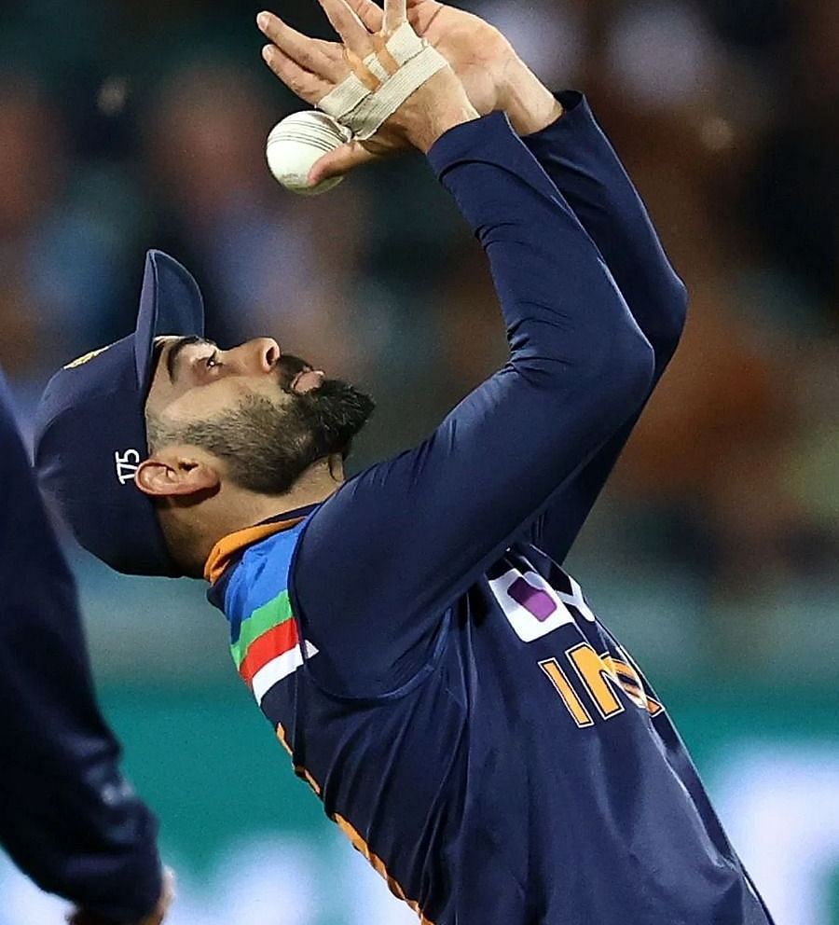
DROP A FUNCTION..
DROP FUNCTION <function_name>;

Slide 34

PL/SQL - Procedures

Slide 35
What is a subprogram?
A subprogram is a program unit/module that performs a particular task. These subprograms are combined to form larger programs. This is basically called the 'Modular design’.
A subprogram can be invoked by another subprogram or program which is called the calling program.

Slide 36
Subprogram
A subprogram can be created :
At the schema level
Inside a package
Inside a PL/SQL block
At the schema level, subprogram is a standalone subprogram. It is created with the CREATE PROCEDURE or the CREATE FUNCTION statement.
It is stored in the database and can be deleted with the DROP PROCEDURE or DROP FUNCTION statement.

Slide 37
A subprogram created inside a package is a packaged subprogram. It is stored in the database and can be deleted only when the package is deleted with the DROP PACKAGE statement
PL/SQL subprograms are named PL/SQL blocks that can be invoked with a set of parameters. PL/SQL provides two kinds of subprograms −
Functions − These subprograms return a single value; mainly used to compute and return a value.
Procedures − These subprograms do not return a value directly; mainly used to perform an action.

Slide 38


Parts of a PL/SQL Subprogram

Slide 39
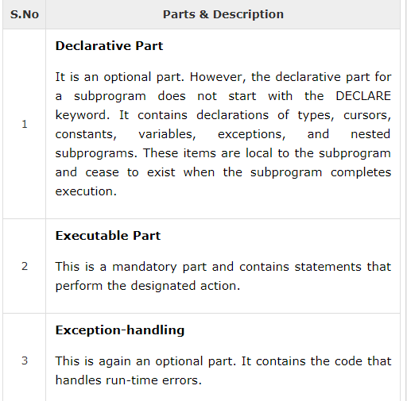

Slide 40
Creating a Procedure
A procedure is created with the CREATE OR REPLACE PROCEDURE statement.
The simplified syntax for the CREATE OR REPLACE PROCEDURE statement is as follows
CREATE [OR REPLACE] PROCEDURE procedure_name
[(parameter_name [IN | OUT | IN OUT] type [, ...])]
{IS | AS}
BEGIN
< procedure_body >
END procedure_name;

Slide 41
Creating a Procedure
Where,
procedure-name specifies the name of the procedure.
[OR REPLACE] option allows the modification of an existing procedure.
The optional parameter list contains name, mode and types of the parameters. IN represents the value that will be passed from outside and OUT represents the parameter that will be used to return a value outside of the procedure.
procedure-body contains the executable part.
The AS keyword is used instead of the IS keyword for creating a standalone procedure.

Slide 42
Example
The following example creates a simple procedure that displays the string 'Hello World!' on the screen when executed.
CREATE OR REPLACE PROCEDURE greeting
AS
BEGIN
dbms_output.put_line('Hello World!');
END;
/

Slide 43
Executing a Standalone Procedure
A standalone procedure can be called in two ways −
Using the EXECUTE keyword
Calling the name of the procedure from a PL/SQL block
The above procedure named 'greeting' can be called with the EXECUTE keyword as −
EXECUTE greeting;
The procedure can also be called from another PL/SQL block −
BEGIN
greeting;
END;
/

Slide 44
Parameter Modes in PL/SQL Subprograms
IN
An IN parameter lets you pass a value to the subprogram.
It is a read-only parameter. Inside the subprogram, an IN parameter acts like a constant.
It cannot be assigned a value.
We can pass a constant, literal, initialized variable, or expression as an IN parameter.
We can also initialize it to a default value; however, in that case, it is omitted from the subprogram call.
It is the default mode of parameter passing. Parameters are passed by reference.
OUT
An OUT parameter returns a value to the calling program.
Inside the subprogram, an OUT parameter acts like a variable.
We can change its value and reference the value after assigning it.
The actual parameter must be variable and it is passed by value.

Slide 45
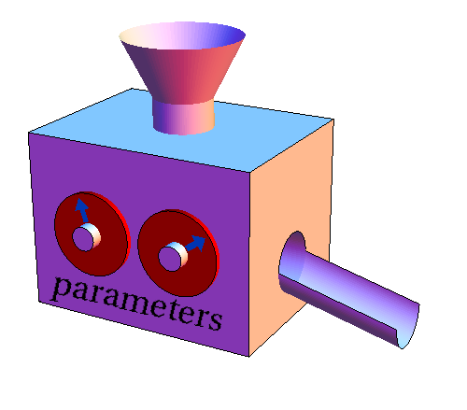
IN OUT
An IN OUT parameter passes an initial value to a subprogram and returns an updated value to the caller.
It can be assigned a value and the value can be read.
The actual parameter corresponding to an IN OUT formal parameter must be a variable, not a constant or an expression.
Formal parameter must be assigned a value.
Actual parameter is passed by value.

Slide 46
IN & OUT Mode Example 1
This program finds the minimum of two values. Here, the procedure takes two numbers using the IN mode and returns their minimum using the OUT parameters.
example

Slide 47
IN & OUT Mode Example 2
This procedure computes the square of value of a passed value. This example shows how we can use the same parameter to accept a value and then return another result.
example

Slide 48
CREATE OR REPLACE PROCEDURE Sum1(a IN number, b IN number) IS
c number;
BEGIN
c := a+b;
dbms_output.put_line('Sum of two nos= '|| c);
END Sum1;
//Calling the procedure
set serveroutput on;
set verify off;
DECLARE
x number;
y number;
BEGIN
x := &x;
y := &y;
Sum1(x,y);
END;

Slide 49
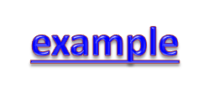
Update salary of an employee by giving the eid and the percent raised as arguments to a procedure
CREATE OR REPLACE PROCEDURE adjust_salary(
in_employee_id IN EMP.EID%TYPE,
in_percent IN NUMBER
) IS
BEGIN
-- update employee's salary
UPDATE emp
SET esal = esal + esal * in_percent / 100
WHERE eid = in_employee_id;
END;

Slide 50


Insert Records through procedure

Slide 51

Deleting a Standalone Procedure
A standalone procedure is deleted with the DROP PROCEDURE statement.
Syntax for deleting a procedure is −
DROP PROCEDURE procedure-name;

Slide 52

PROCEDURES
FUNCTIONS

Slide 53
Procedures vs Functions
A stored procedure can optionally return values using out parameters ,but can also be written in a manner without returning a value but a function must return a value
A stored procedure cannot be used in a select statement whereas the functions can be used in a select statement .
Procedure is named PL/SQL block which performs one or more tasks. where function is named PL/SQL block which performs a specific action.
Procedure may or may not return value whereas function should return one value.

Slide 54
Procedures vs Functions
1. Function is mainly used in the case where it must return a value. Whereas a procedure may or may not return a value or may return more than one value using the OUT parameter.
2. Function can be called from SQL statements whereas procedure can not be called from the sql statements
3. Functions are normally used for computations whereas procedures are normally used for executing business logic.
4. You can have DML (insert,update, delete) statements in a function. But you cannot call such a function in a SQL query.

Slide 55
Procedures vs Functions
5. Function returns 1 value only. Procedure can return multiple values (max 1024).
6.Stored procedure returns always integer value by default zero. whereas function return type could be scalar or table or table values
7.A procedure may modify an object where a function can only return a value The RETURN statement immediately completes the execution of a subprogram and returns control to the caller.

Slide 56
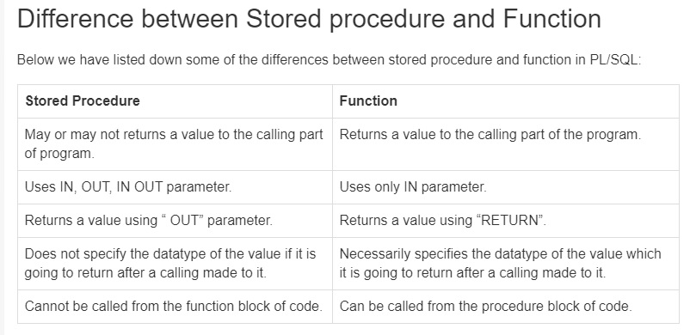
Summary…

Slide 57

Advantages of a Stored Procedure or Function

Slide 58

1. Improves Database Performance
Compilation is automatically done by oracle engine.
Whenever the calling of procedure or function is done ,the oracle engine loads the compiled code into a memory area called System Global Area(SGA) due to which execution becomes faster.
2. Provides Reusability and avoids redundancy
The same block of code for procedure or function can be called any number of times for working on multiple data.
Due to which number of lines of code cannot be written repeatedly.

Slide 59

2. Provides Reusability and avoids redundancy
The same block of code for procedure or function can be called any number of times for working on multiple data.
Due to which number of lines of code cannot be written repeatedly.

Slide 60

3. Maintains Integrity
Integrity means accuracy.
Use of procedure or function ensures integrity because they are stored as database objects by the oracle engine.

Slide 61

4. Maintains Security
Use of stored procedure or function helps in maintaining the security of the database as access to them and their usage can be controlled by granting access/permission to users while the permission to change or to edit or to manipulate the database may not be granted to users.

Slide 62

5. Saves Memory
Stored procedure or function have shared memory. Due to which it saves memory as a single copy of either a procedure or a function can be loaded for execution by any number of users who have access permission.

Slide 63
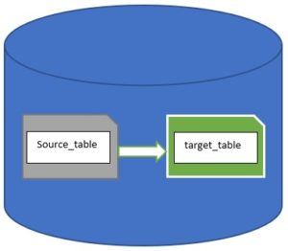
How to copy data from one table to another on Oracle?
Oracle database has syntax “CREATE TABLE … AS SELECT … “which allows you copy data from one table to another without predefining the target table.
If WE want to create a copy of source table with data. You can write a simple query like below
CREATE TABLE target_table
As
SELECT *
FROM source_table;

Slide 64
If we want to create a copy of source table without copying the data then we can just add where clause that will not select any data.
CREATE TABLE target_table
As
SELECT *
FROM source_table WHERE 1=2;

